Slide 1
<!DOCTYPE >
<html>
<head>
<h1>Forms</h1>
</head>
<main>
<header>
<h1> </h1>
<h2> </h2>
<h2> </h2>
<h2> </h2>
<h2> </h2>
<h2> </h2>
<h2> </h2>
</header>
<body>
<form>
First name:
<br>
<input type="text" name="firstname">
<br>
CHAPTER 11 FORMS
Michael Rutkowski
Philip Carl
Josh Corbin
Brett Worley
Michael Kay
Ethan Lavarnway

Slide 2
What are Forms
Forms allow the user to input data to the website.
The input data can then be sent to the web server to be processed.

Slide 3
Attributes
Form Elements
Name: Client side code
Action:
Method
Target
Input Elements
Type
Name
Disabled
Readonly

Slide 4
Types of forms
Button
Text field
Radio button and checkbox
Drop down list
List boxes
Text areas
Labels
Group controls
Upload files

Slide 5

Button
This provides a clickable button. This button can contain images or text on it.

Slide 6
Text Field
This input method allows text input. The default width is 20 characters.

Slide 7
Radio Buttons and Checkboxes
These buttons can be marked to determine user input. When Checkboxes are implemented the user may select multiple options. When a Radio button is implemented the user may select multiple choices.

Slide 8
Drop-down List
Provides the user with a list of default values that they may choose from by clicking the form button and selecting an item from the drop down list.

Slide 9
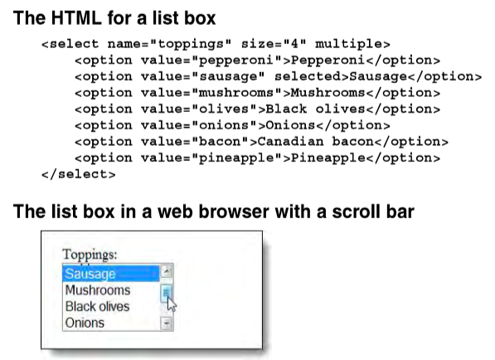
List Box
Similar to a drop-down list but the number of options can be specified so that all of the options are not shown and a scroll can be used.
By default only one option can be selected.

Slide 10
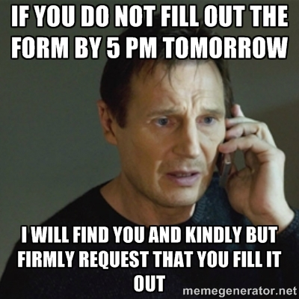
Text Areas
A Text area may hold an unlimited amount of characters but the width and height can be adjusted.

Slide 11
Labels
Labels are Text that appears the right of the form input.
Should be used to improve the accessibility of forms.

Slide 12
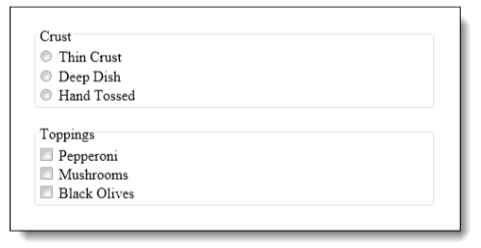
Group Control
Uses the fieldset command to group controls.
Would make it easier to disable or hide multiple related controls.

Slide 13

File Upload
This form action prompts the user for file input from the computer.

Slide 14
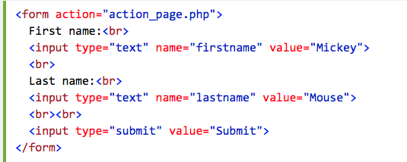
Submit Button
The input type “submit” is used to return the data to the server side.

Slide 15
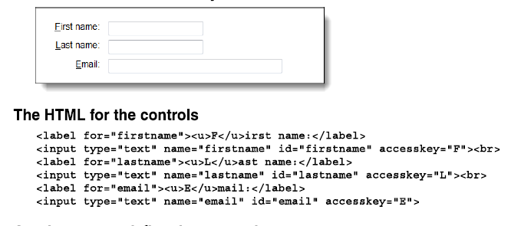
Tabindex
The tabindex is defined by the order that the forms are put in the html but negates labels.
An access key can be used to assign an accesskey to a label to select the text box related to it.

Slide 16
Activity:

